Slide 1

Project Aragog
Brock Bye, Will Nichols, Jake Borham
CAO: 04/28/2023
Notes:
In attendance:

Slide 2
Architectural Overview
Inspired by arduino project Original Design by Regis Hsu
Concept of Operations
SPI Communication
Circuit Design
Body Composition

Slide 3
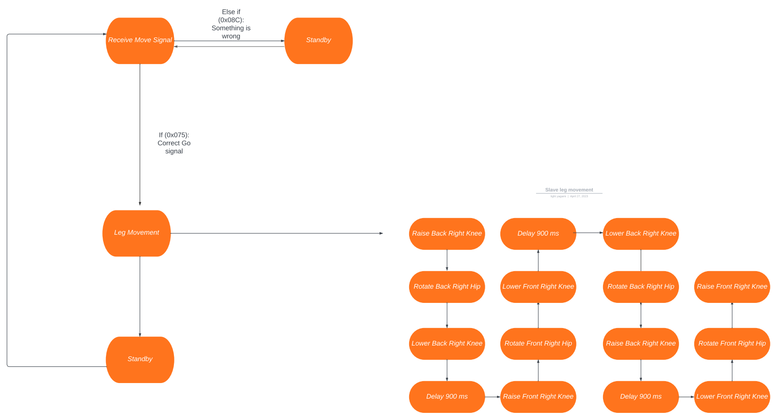
Concept of Operations (Slave)

Slide 4
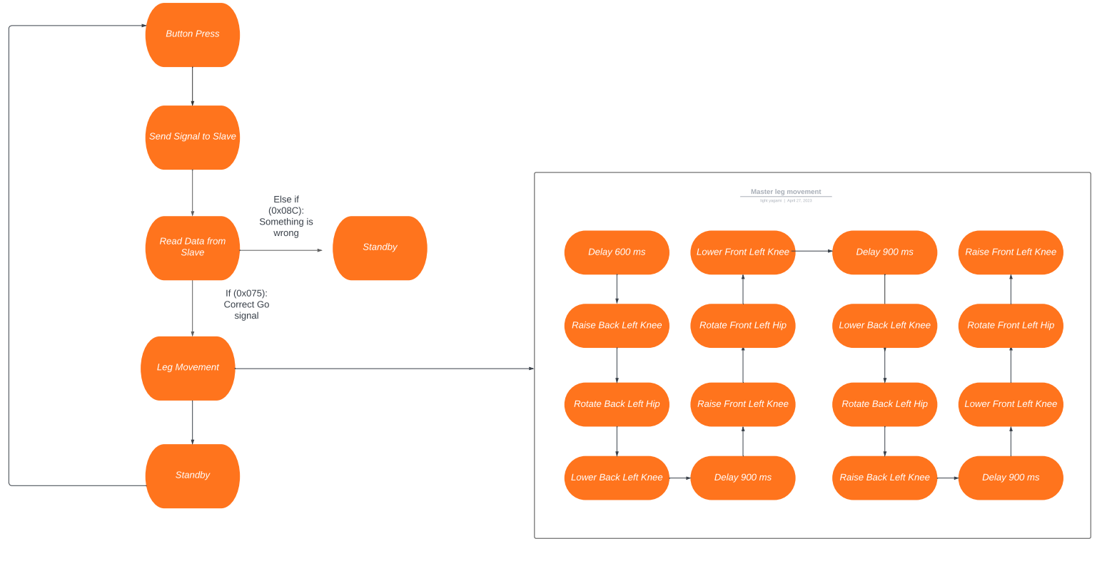
Concept of Operations (Master)

Slide 5
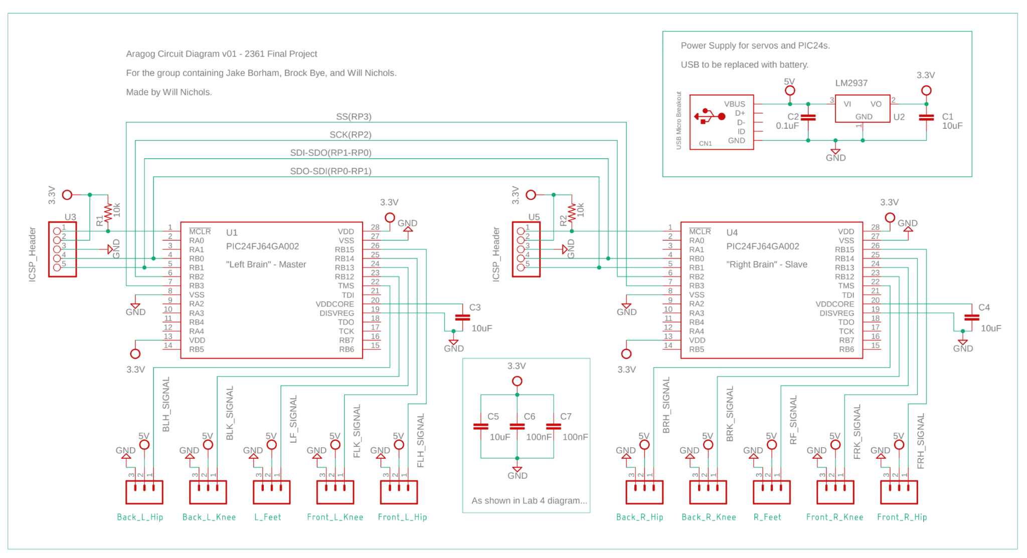
Schematic Overview
Concept of Operations

Slide 6
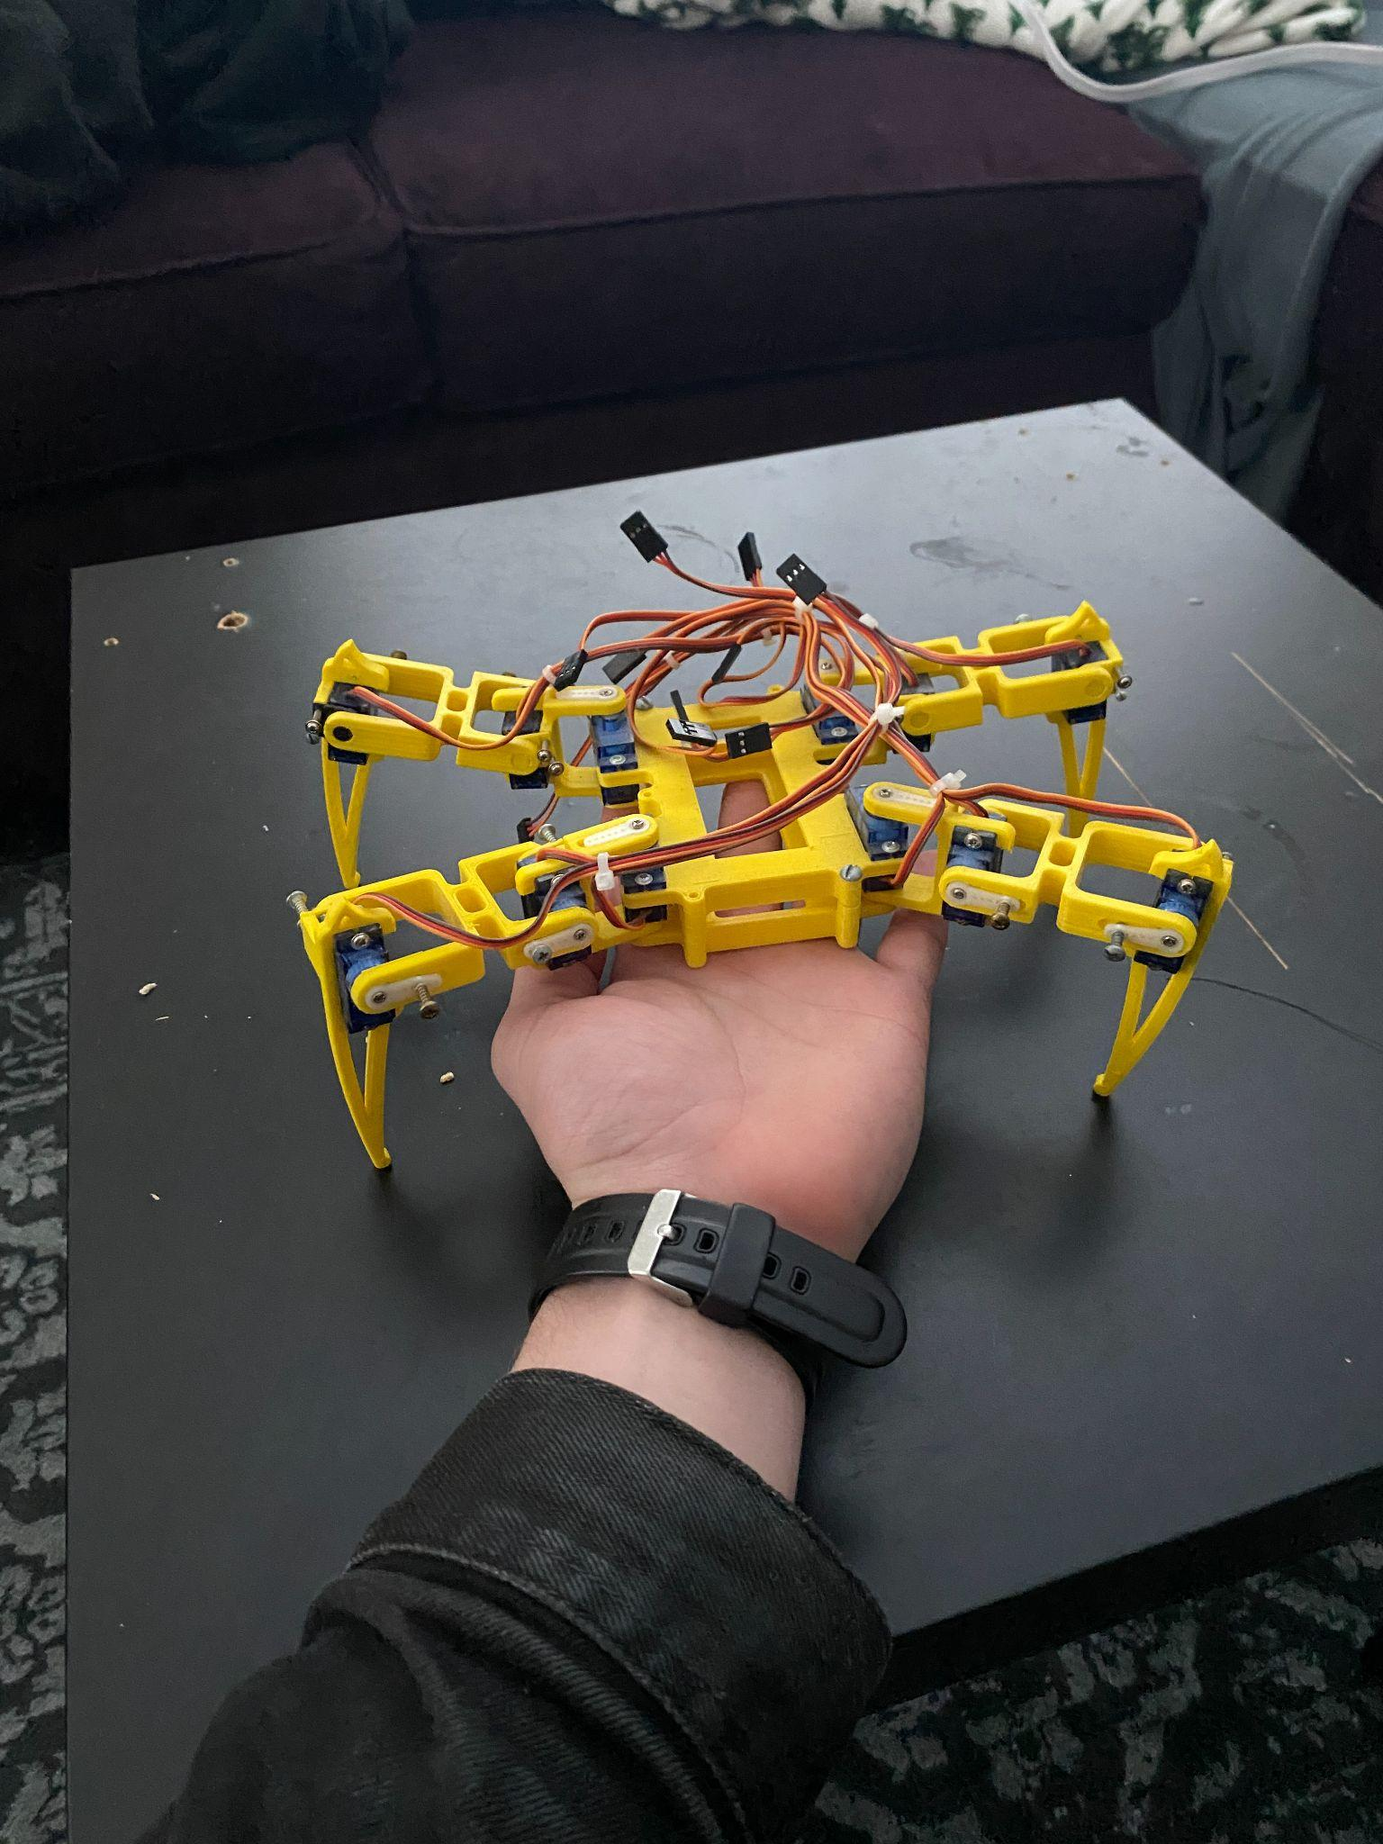
Chassis
Concept of Operations

Slide 7
Member Contributions
Hardware Design
Use of two PICs (Jake)
Circuit layout & analysis (Will)
Chassis design/production (Will)
SPI Communication
Master/Slave setup (Brock)
Read/Write and Interrupt functions (Will)
Movement Scripts
Servo setup functions (Jake)
Leg movement logic (Jake/Brock)
Leg movement hard coded (Brock)

Slide 8
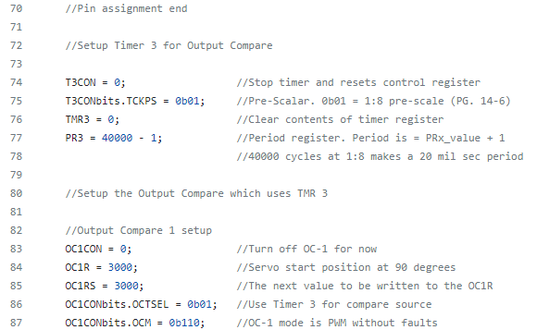
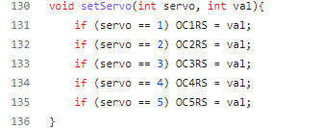
API Libraries (General)

Slide 9
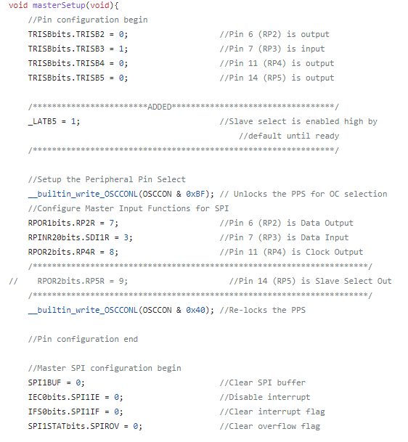
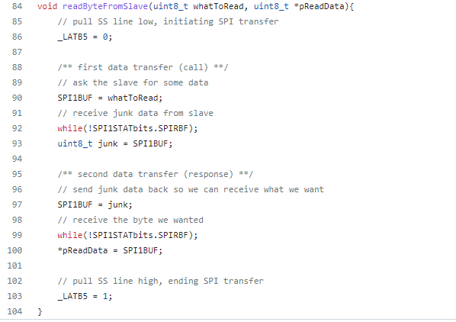
API Libraries (Master SPI)

Slide 10
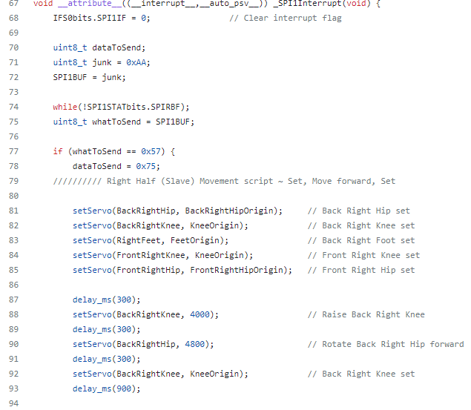
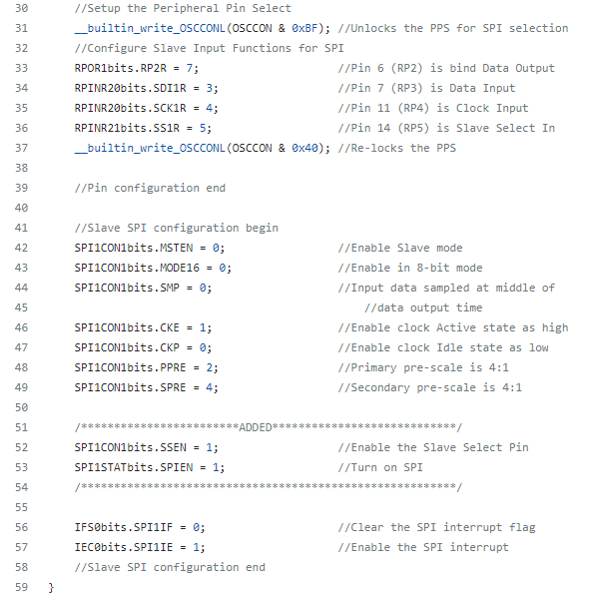
API Libraries (Slave SPI)

Slide 11
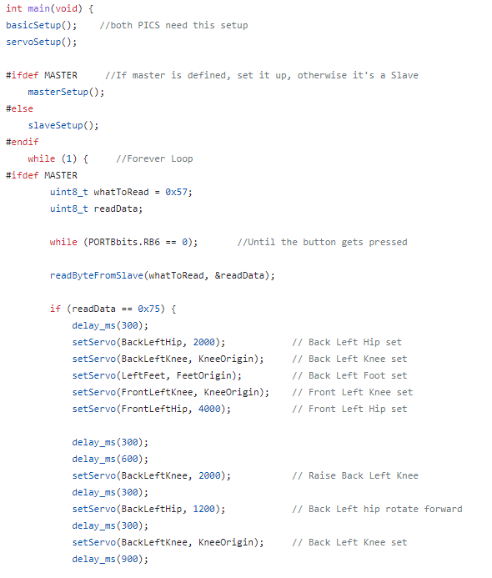
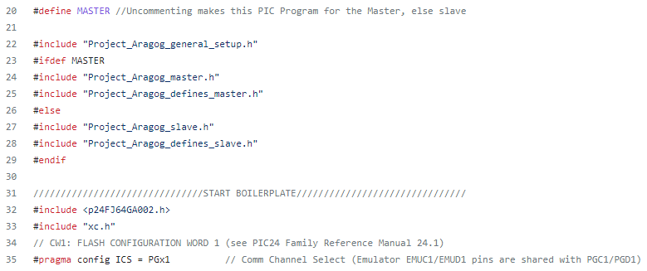
API Libraries(Main)

Slide 12
Setbacks
SPI concept comprehension and implementation
Power consumption
Servo power intake
Single source supply
Battery supply
Perf board implementation
Servo burnouts

Slide 13
Future improvements
Upgraded servos
Upgraded chassis
PCB implementation
Mobility
More SPI communication
More movement functions and logic

Slide 14
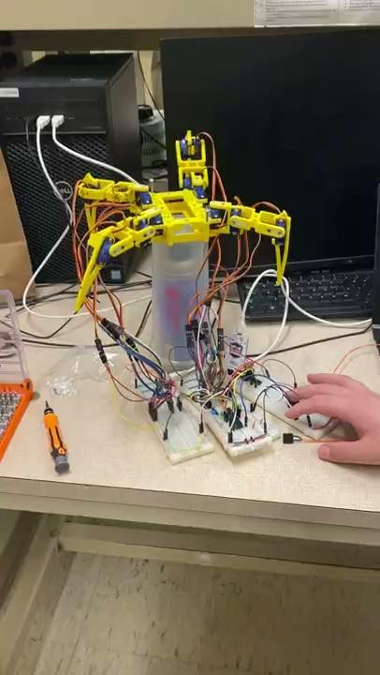
Project Development

Slide 15
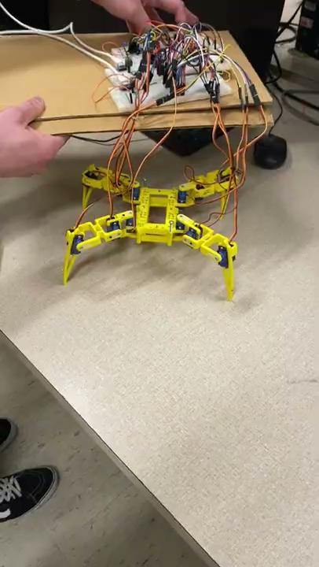
Project Development

Slide 16
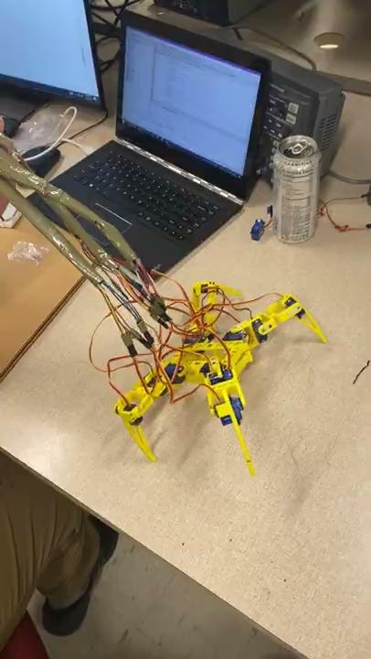
Project Development

Slide 17
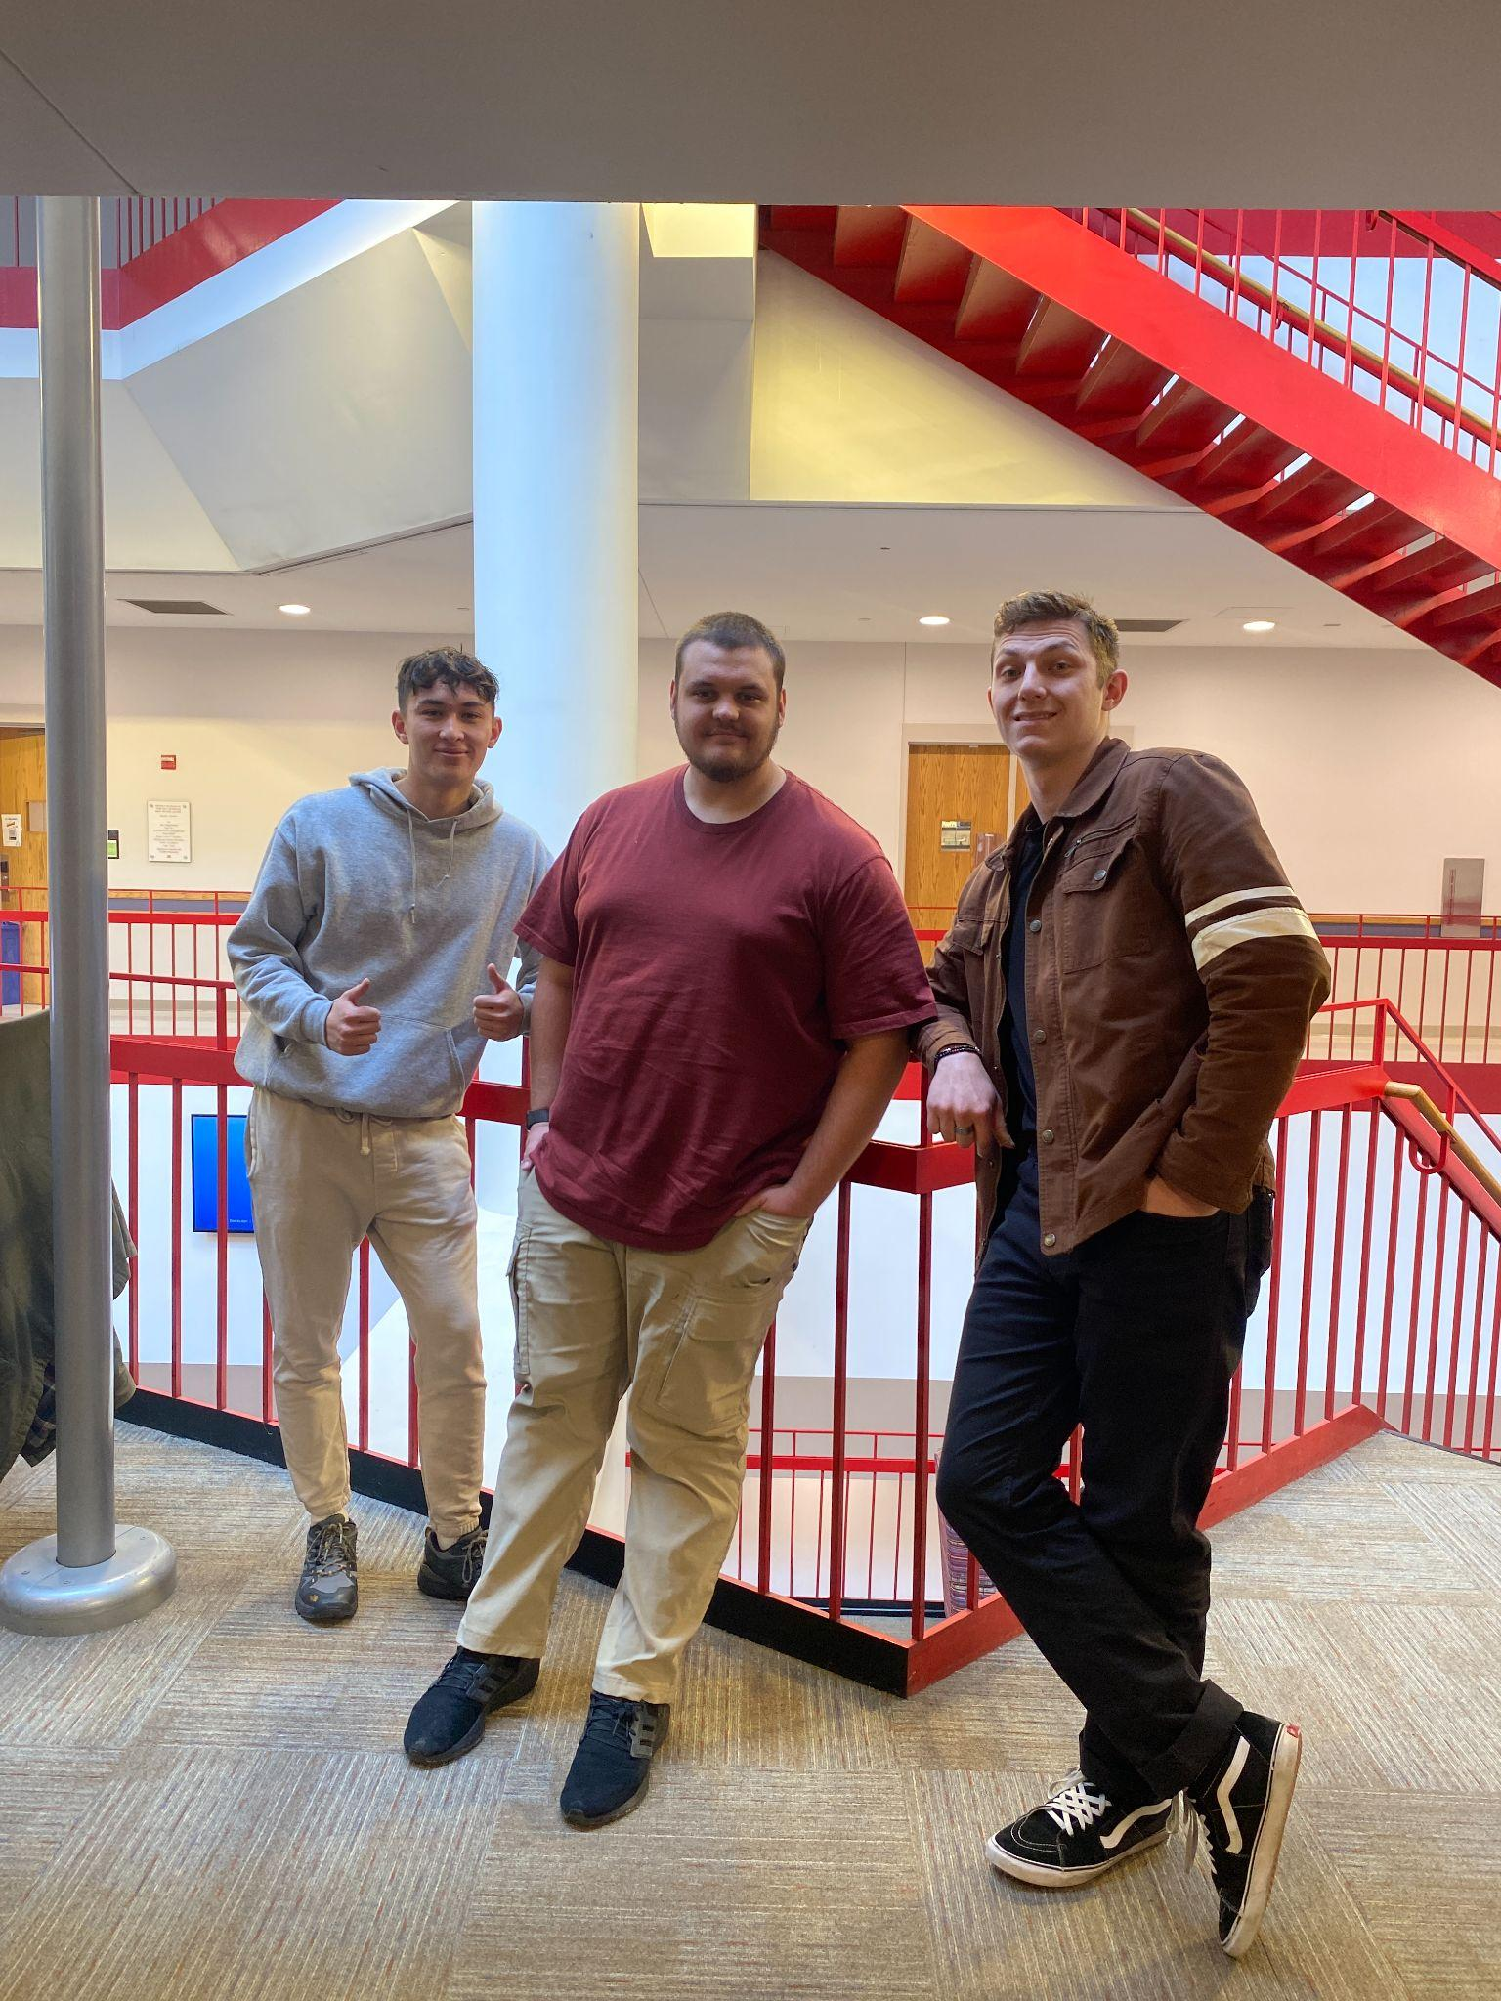
Conclusion
Questions?

